Slide 1
Software Engineering for CS
Week 4,5
Instructor : dr. Natash Ali Mian
School of Computer and Information Technology
Beaconhouse National University

Slide 2
`
Switch off mobile phones during lectures,
or
put them into silent mode

Slide 3
Requirement???
Features, Functionality of the system?
Wanted or Needed?
Needs?
Requirement Engineering?
Gathering to Finalization.

Slide 4
Introduction
Requirements form the basis for all software products
Requirements engineering is the process, which enables us to systematically determine the requirements for a software product

Slide 5
Requirement
Something required, something wanted or needed
Webster’s dictionary
There is a huge difference between wanted and needed and it should be kept in mind all the time

Slide 6
Software Requirements - 1
A complete description of what the software system will do without describing how it will do it is represented by the software requirements

Slide 7
Software Requirements - 2
Software requirements are complete specification of the desired external behavior of the software system to be built
They also represent External behavior of the system

Slide 8
Software Requirements - 3
Software requirements may be:
Abstract statements of services and/or constraints
Detailed mathematical functions

Slide 9
Software Requirements - 4
Software requirements may be:
Part of the bid of contract
The contract itself
Part of the technical document, which describes a product

Slide 10
IEEE Definition
A condition or capability that must be met or possessed by a system...to satisfy a contract, standard, specification, or other formally imposed document
IEEE Std 729

Slide 11
Sources of Requirements
Stakeholders
People affected in some way by the system
Documents
Existing system
Domain/business area

Slide 12
Sources of Requirements
Stakeholders
People affected in some way by the system
Owner (Investor)
Users
The team working on the software and responsible for maintaining it
External
Competitors
News agencies
Influencers
Government
Documents
Existing system
Domain/business area

Slide 13
Levels of Software Requirements
Stakeholders describe requirements at different levels of detail
“What versus How”
“One person’s floor is another person’s ceiling”

Slide 14
Importance of Software Requirements
The hardest single part of building a software system is deciding what to build...No other part of the work so cripples the resulting system if done wrong. No other part is difficult to rectify later, Fred Brooks

Slide 15
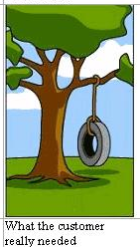

Slide 16
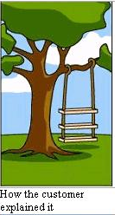

Slide 17
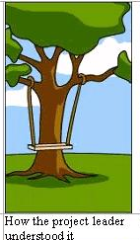

Slide 18
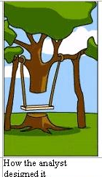

Slide 19


Slide 20
Here is the complete story

Slide 21
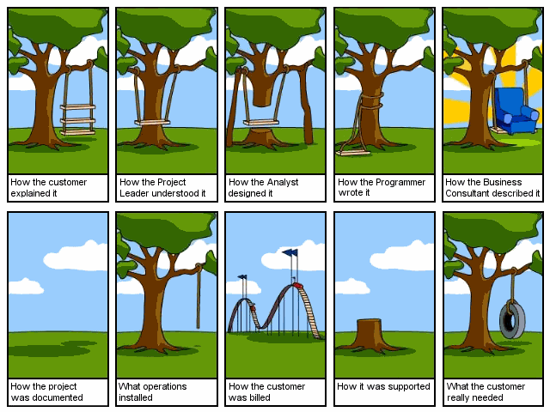

Slide 22
Examples of Requirements - 1
The system shall maintain records of all payments made to employees on accounts of salaries, bonuses, travel/daily allowances, medical allowances, etc.

Slide 23
Examples of Requirements - 2
The system shall interface with the central computer to send daily sales and inventory data from every retail store

Slide 24
Examples of Requirements - 3
The system shall maintain records of all library materials including books, serials, newspapers and magazines, video and audio tapes, reports, collections of transparencies, CD-ROMs, DVDs, etc.

Slide 25
Examples of Requirements - 4
The system shall allow users to search for an item by title, author, or by International Standard Book Number
The system’s user interface shall be implemented using a web browser

Slide 26
Examples of Requirements - 5
The system shall support at least twenty transactions per second
The system facilities which are available to public users shall be demonstrable in ten minutes or less

Slide 27
Kinds of Software Requirements

Slide 28
Kinds of Software Requirements
Functional requirements
Non-functional requirements
Domain requirements
Inverse requirements
Design and implementation constraints

Slide 29
Functional Requirements - 1
Statements describing what the system does
Functionality of the system

Slide 30
Functional Requirements - 2
Statements of services the system should provide
Reaction to particular inputs
Behavior in particular situations

Slide 31
Functional Requirements - 3
Sequencing and parallelism are also captured by functional requirements
Abnormal behavior is also documented as functional requirements in the form of exception handling

Slide 32
Functional Requirements - 4
Functional requirements should be complete and consistent
Customers and developers usually focus all their attention on functional requirements

Slide 33
Functional Requirements Example # 1
The system shall solve a quadratic equation using the following formula
x = (-b+sqrt(b² – 4*a*c))/2*a

Slide 34
Functional Requirements Example # 2
The user shall be able to search either the entire database of patients or select a subset from it (admitted patients, or patients with asthma, etc.)

Slide 35
Functional Requirements Example # 3
The system shall provide appropriate viewers for the user to read documents in the document store

Slide 36
Functional Requirements Example # 4
Every order shall be allocated a unique identifier (ORDER_ID) which the user shall use to access that order

Slide 37
Functional Requirements Example # 5
The system shall allow customers to return non-perishable items within fifteen days of the purchase. A customer must present the original sale receipt to return an item

Slide 38
Comments on Examples
Notice the level of detail in different requirements described above. Some are very detailed compared to others

Slide 39
Comments on Examples
Notice the ambiguity in the requirement, which uses the term ‘appropriate viewers’
This requirement does not mention the formats of documents and types of viewers, which can be used

Slide 40
Comments on Examples
Notice the ambiguity in the requirement for solving the quadratic equation. The requirement does not speak about the possibility when the value of ‘a’ is zero
x = (-b+sqrt(b² – 4*a*c))/2*a

Slide 41
Comments on Examples
Incomplete and ambiguous requirements are open to multiple interpretations and assumptions
This can lead to the development of poor quality, or faulty, software products

Slide 42
Non-Functional Requirements - 1
Most non-functional requirements relate to the system as a whole. They include constraints on timing, performance, reliability, security, maintainability, accuracy, the development process, standards, etc.

Slide 43
Non-Functional Requirements - 2
They are often more critical than individual functional requirements
Capture the emergent behavior of the system, that is they relate to system as a whole
Many non-functional requirements describe the quality attributes of the software product

Slide 44
Non-Functional Requirements - 3
For example, if an aircraft system does not meet reliability requirements, it will not be certified as ‘safe’
If a real-time control system fails to meet its performance requirements, the control functions will not operate correctly

Slide 45
Non-Functional Requirements - 4
Non-Functional
requirements
Product
requirements
Organizational
requirements
External
requirements

Slide 46
Product Requirements - 1
Product
requirements
Usability
requirements
Efficiency
requirements
Reliability
requirements
Portability
requirements
Performance
requirements
Space
requirements

Slide 47
Product Requirements
The system shall allow one hundred thousand hits per minute on the website
The system shall not have down time of more than one second for continuous execution of one thousand hours

Slide 48
Organizational Requirements - 1
Organizational
requirements
Standards
requirements
Implementation
requirements
Delivery
requirements

Slide 49
External Requirements - 1
External
requirements
Interoperability
requirements
Ethical
requirements
Legislative
requirements
Privacy
requirements
Safety
requirements

Slide 50
External Requirements - 2
The system shall not disclose any personal information about members of the library system to other members except system administrators
The system shall comply with the local and national laws regarding the use of software tools

Slide 51
Observations on Non-Functional Requirements - 1
Non-functional requirements are written to reflect general goals for the system. Examples include:
Ease of use
Recovery from failure
Rapid user response

Slide 52
Observations on Non-Functional Requirements - 2
Goals are open to misinterpretation
Objective verification is difficult
Distinction between functional and non-functional is not always very clear

Slide 53
Observations on Non-Functional Requirements - 3
Non-functional requirements should be written in a quantitative manner as much as possible, which is not always easy for customers
For some goals, there are no quantitative measures, e.g., maintainability

Slide 54
Observations on Non-Functional Requirements - 4
Goals can be useful to designers and developers, as they give clues to them about priorities of the customers

Slide 55
Observations on Non-Functional Requirements - 5
Chances of conflicts within non-functional requirements are fairly high, because information is coming from different stakeholders. For example, different stakeholders can give different response times or failure tolerance levels, etc.

Slide 56
Observations on Non-Functional Requirements - 6
Some negotiations must be done among different stakeholders, to achieve an agreement in these situations

Slide 57
Observations on Non-Functional Requirements - 7
Non-functional requirements should be highlighted in the requirements document, so that they can be used to build the architecture of the software product

Slide 58
Domain Requirements - 1
Requirements that come from the application domain and reflect fundamental characteristics of that application domain
Can be functional or non-functional
These requirements, sometimes, are not explicitly mentioned, as domain experts find it difficult to convey them. However, their absence can cause significant dissatisfaction

Slide 59
Domain Requirements - 2
Domain requirements can impose strict constraints on solutions. This is particularly true for scientific and engineering domains
Domain-specific terminology can also cause confusion

Slide 60
Inverse Requirements
They explain what the system shall not do. Many people find it convenient to describe their needs in this manner
These requirements indicate the indecisive nature of customers about certain aspects of a new software product

Slide 61
Design and Implementation Constraints - 1
They are development guidelines within which the designer must work, which can seriously limit design and implementation options
Can also have impact on human resources

Slide 62
Requirements Engineering Process
The process(es) involved in
developing system requirements is
collectively known as
Requirements Engineering Process

Slide 63
RE Process - Inputs and Outputs
Existing
systems
information
Stakeholder
needs
Agreed
requirements
Requirements
Engineering Process
Organizational
standards
System
specification
System
models
Regulations
Domain
information

Slide 64
RE Process – Inputs
It includes:
Existing system information
Information about the functionality of systems to be replaced
Information about other systems, which interact with the system being specified

Slide 65
RE Process – Inputs
Stakeholder needs
Description of what system stakeholders need from the system to support their work
Organizational standards
Standards used in an organization regarding system development practice, quality management, etc.

Slide 66
RE Process – Inputs
Regulations
External regulations such as health and safety regulations, which apply to the system
Domain information
General information about the application domain of the system

Slide 67
RE Process – Outputs
It includes
Agreed requirements
A description of the system requirements, which is understandable by stakeholders and which has been agreed by them

Slide 68
RE Process – Outputs
System specification
This is a more detailed specification of the system, which may be produced in some cases

Slide 69
RE Process – Outputs
System models
A set of models such as a data-flow model, an object model, a process model, etc., which describes the system from different perspectives

Slide 70
Thanks

